Slide 1
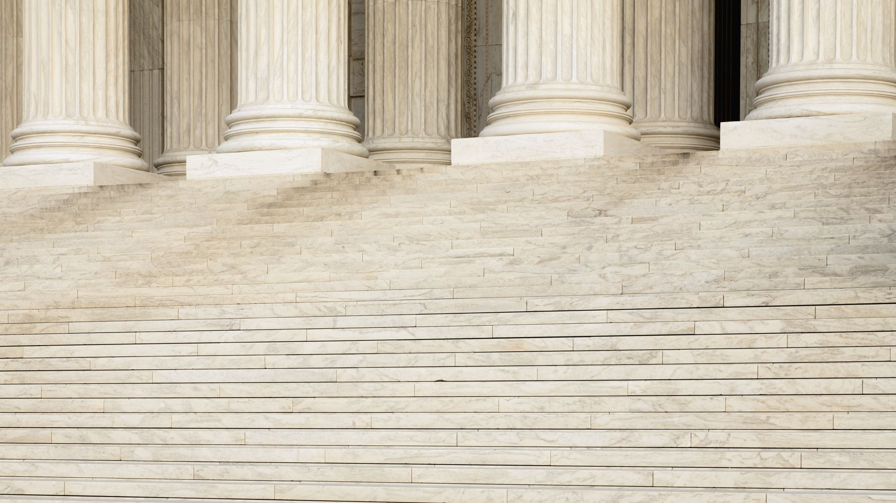

Presentation to the Illinois House Redistricting Committee
Prepared by Valerie F. Leonard
Founder, Nonprofit Utopia, LLC
April 17, 2021

Slide 2
We thank Speaker Welch, Representative Hernandez, Representative Tarver, Representative LaShawn Ford and Representative Collins for adding today’s hearing to focus on Cook County and Chicago’s West Side communities.
We appreciate your taking the time from your extremely busy schedules to listen to our concerns.
We also want to let you know that we appreciate your staff’s outreach efforts to ensure that as many people who wanted the opportunity to voice their concerns could do so.

Slide 3
South Side Hearings
We thank you for honoring our request to hold a hearing focusing on Chicago’s West Side and Western Suburbs.
We respectfully request that you also host at least one redistricting hearing for Black communities on Chicago’s South Side to ensure that they have an opportunity to provide input into the drawing of their district boundaries.
Given our declining population and prison gerrymandering, Blacks could be more negatively impacted than any ethnic group in the City, we think it important that those most impacted have an opportunity to weigh in.

Slide 4
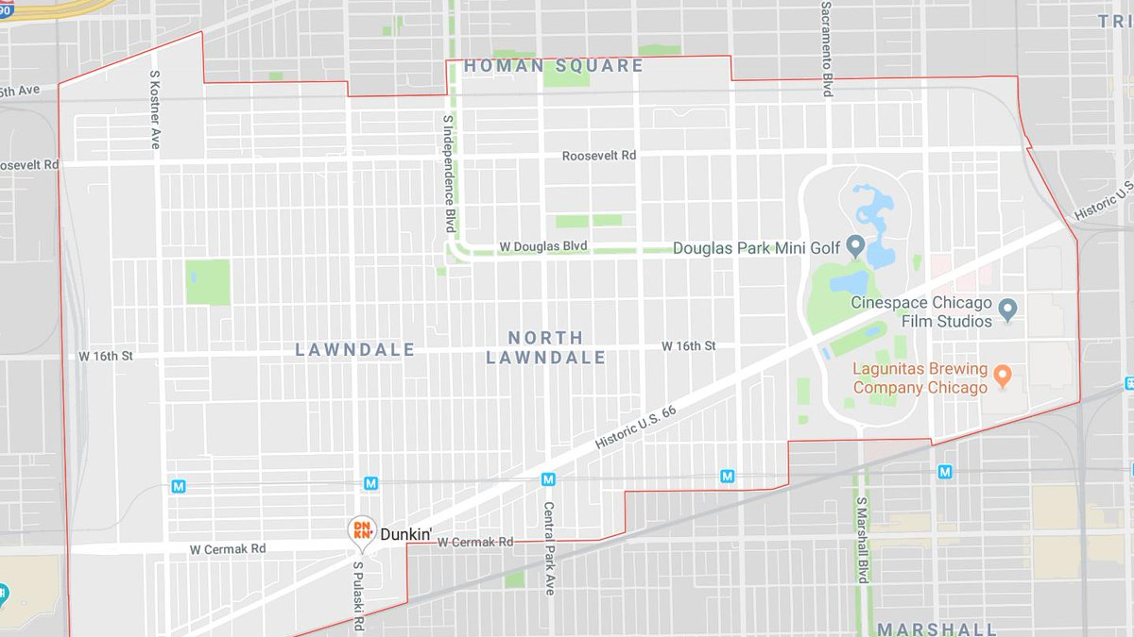
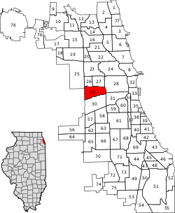
North Lawndale Community

Slide 5
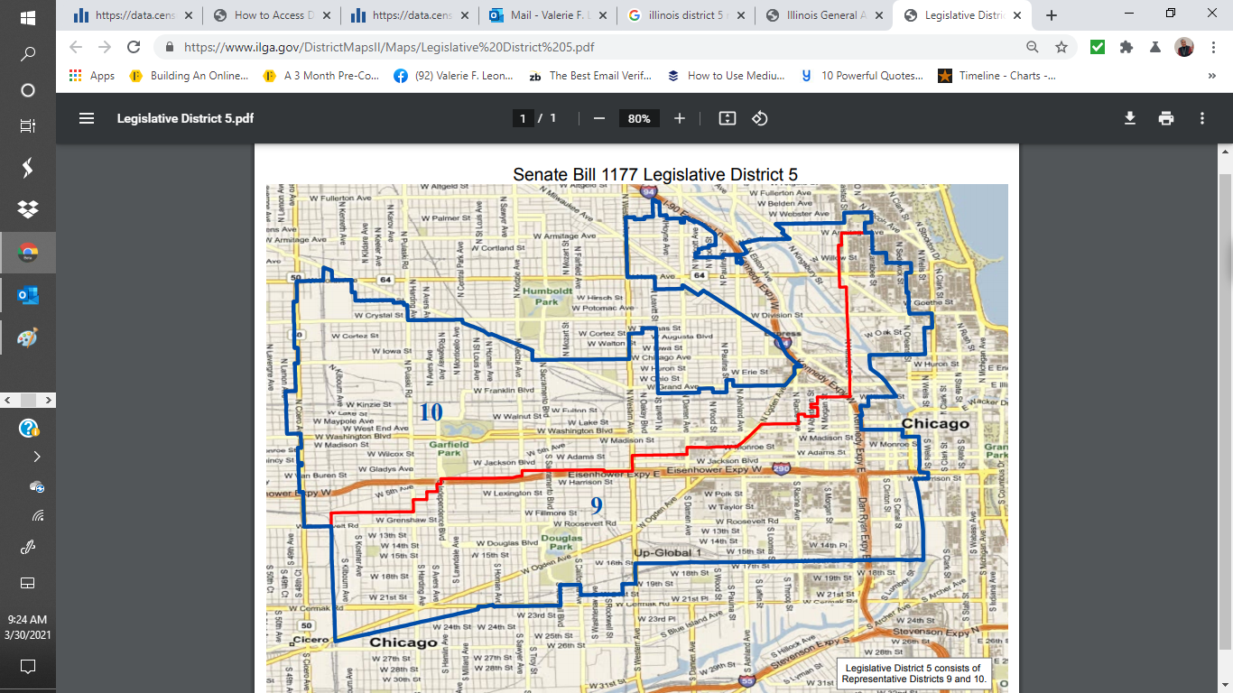

Slide 6
Illinois Senate District 5 Demographics
Source: Census.gov

Slide 7
Illinois Legislative District 9 Demographics
Source: Census.gov

Slide 8
Illinois Legislative District 10 Demographics
Source: Census.gov

Slide 9

What Do the Data Suggest?
Three districts that were majority Black are now a plurality Black.
The Latino population in these districts have outpaced the growth of the districts overall
While the Asian population growth has also grown at a faster rate than the districts, Asians still do not have sufficient population to have a majority or plurality in any district
The White population is increasing, and allows Whites to have significant influence

Slide 10

What Are the Implications?
If the boundaries remain the same, the districts will be drawn with a plurality of Blacks
There may or may not be enough Blacks to create one majority Black legislative district, where there were 3 before (2 legislative and one senate)

Slide 11
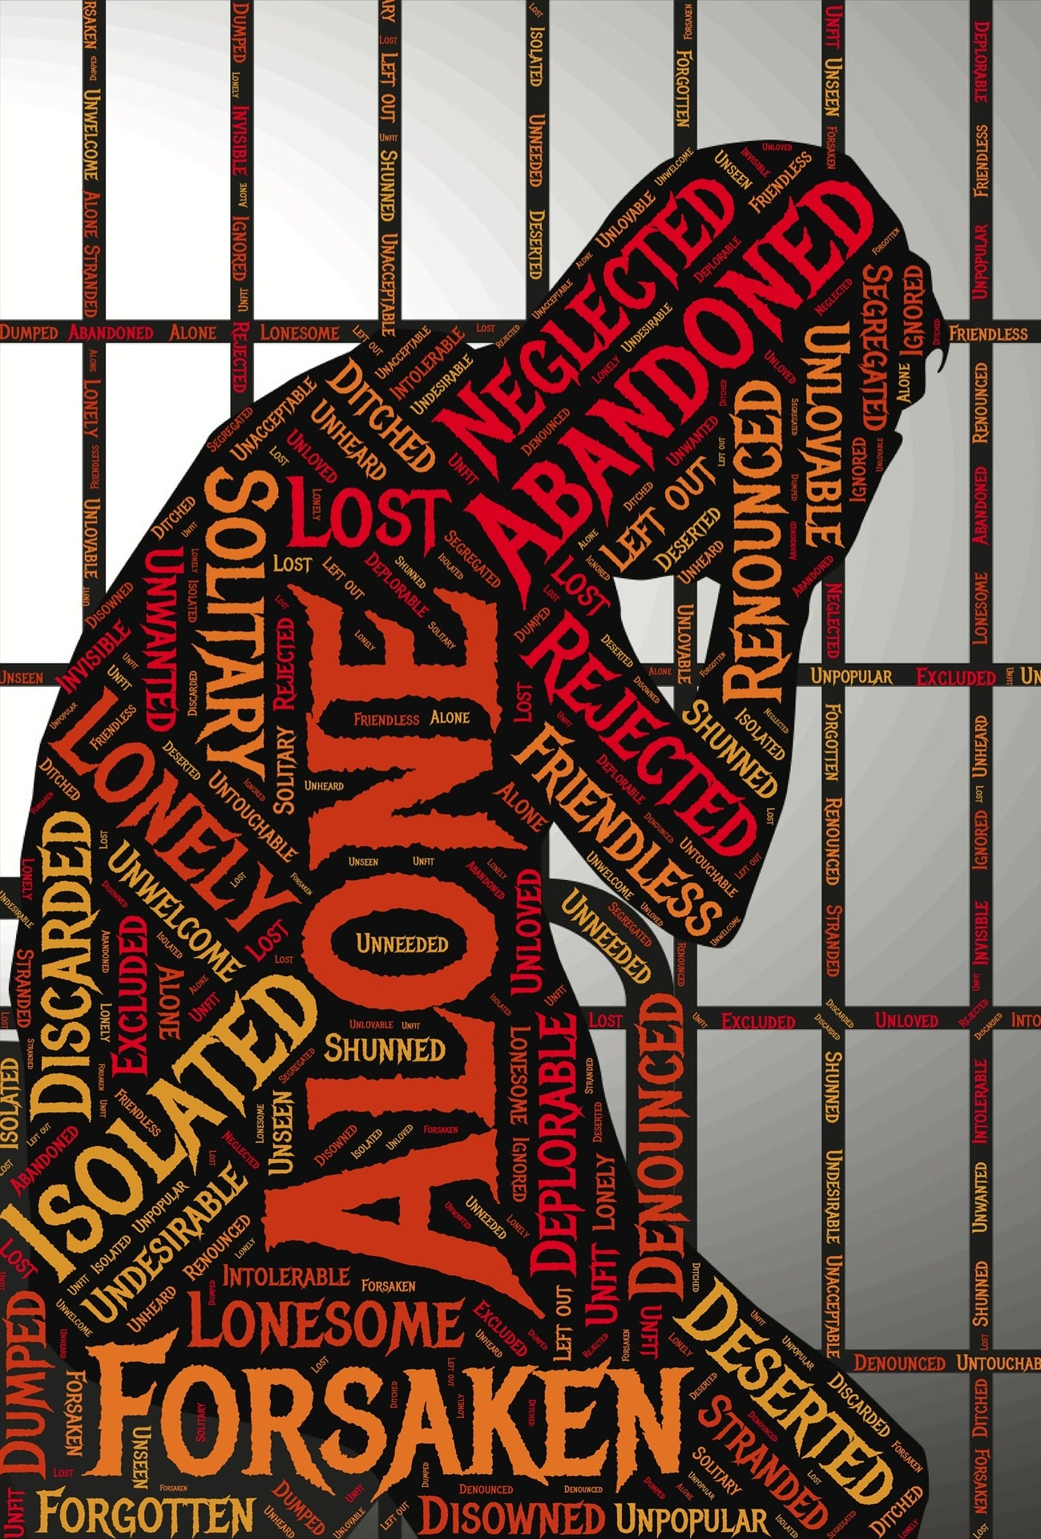
Prison Gerrymandering is Hurting Cook County, Especially The Black Community
It should be noted that as of September 30, 2020, which includes the October 15th deadline for Census taking, there were 30,894 prisoners in the Illinois Department of Corrections prisons.
Of that number, 13,565 were from Cook county, or 44%.
Nine thousand, eight hundred seventy-two (9,872), or 73% were Black.

Slide 12

Prison Gerrymandering is Hurting Cook County, Especially The Black Community
In 2017, the State of Illinois received $55,855,815,000 in Census-driven funding.
This translates into $4,415 per person per year, or $59,895,979 per annum in 2017 dollars.

Slide 13
Prison Gerrymandering is Hurting Cook County, Especially The Black Community
Multiply this by the 10 year Census cycle, we are talking about losing up to $598,959,790.00 in resources that could have been coming to Cook County over the next 10 years.
Instead, these resources are going to prison towns and communities. About $43.7 million per year could be going to Black communities in Cook County, assuming that all the prisoners are from predominantly Black communities.
This translates into $437 million over the next ten years, if the funding formula stays the same. The Black Communities across Cook County could use this money to shore up under-resourced schools, build affordable housing and improve access to health care.

Slide 14
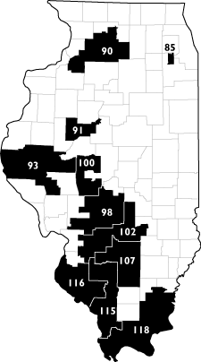
Districts Where At Least 2% of the Population is Incarcerated
There are 11 legislative districts in Illinois in which 2%-3.4% of their populations were incarcerated.
As a result, their populations are over-stated by as much as 3.4%, while the prisoners’ hometown populations are understated.
Source: https://www.prisonersofthecensus.org/illinois/importing.html

Slide 15
Zip Codes With The Highest Number of Returning Prisoners
Zip Code | Returning Prisoners
60608 | 1,570
60607 | 923
60624 | 779
60644 | 679
60651 | 616
60623 | 540
60621 | 428
 | 5,535
6 of the 10 Illinois Zip Codes with the most returning prisoners are on Chicago’s West Side, with all or some land mass in Senate District 5.
Source: CBS Local 2013

Slide 16
The Ask
Hold at least one hearing on Chicago’s South Side
To the extent possible, keep the North Lawndale community together.
  Don’t create any maps with legislative boundaries going through the community. Where possible, boundaries should go around the community
End Prison Gerrymandering effective immediately
  Illinois Senate District 5 includes some or all of the land mass from 6 of the top 10 Illinois zip codes prisoners are likely to return when they are released. Yet, they will be counted Downstate, rather than in Senate District 5 or North Lawndale
  Even though legislation was passed to end prison gerrymandering, it won’t take effect until 2025, which effectively means 2031. We need our money now to take care of prisoners and address other issues like school funding, health care, etc.
Draw as many majority-Black legislative districts as the data will allow.

Slide 17


Questions?
Questions regarding this presentation may be addressed to
  Valerie F. Leonard
  Founder, Nonprofit Utopia
  valeriefleonard@nonprofitutopia.com
  773-571-3886
Photo: Atlanta Speech Therapy

